Slide 1
Opening Remarks of Research Forum Deep Learning and Security Workshop 2017
Chang Liu
UC Berkeley

Slide 2
Deep Learning and Security is a trending topic in academia in 2017
Best Papers in Security Conferences
Towards Evaluating the Robustness of Neural Networks (Oakland 2017 Best Student Paper)
DolphinAtack: Inaudible Voice Commands (CCS 2017 Best Paper)
Best Paper in Other Top-Tier Conferences
Understanding Black-box Predictions via Influence Functions (ICML 2017 Best Paper)
DeepXplore: Automated Whitebox Testing of Deep Learning Systems (SOSP 2017 Best Paper)
Semi-supervised Knowledge Transfer for Deep Learning from Private Training Data (ICLR 2017 Best Paper)

Slide 3
Overview of Deep Learning and Security in 2017
Security of Deep Learning
Applying deep learning to solve security challenges
Remarks on our Research Forum

Slide 4
Adversarial examples in autonomous driving
Stop Sign
Yield Sign

Slide 5
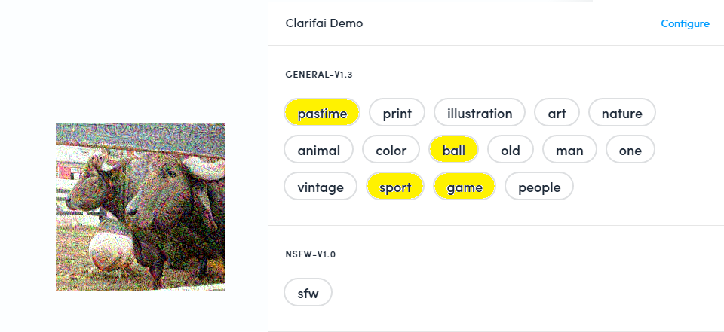
Adversarial examples against a black-box system
Ground truth: water buffalo
Target label: rugby ball
Yanpei Liu, Xinyun Chen, Chang Liu, Dawn Song. Delving into Transferable Adversarial Examples and Black-box Attacks. ICLR 2016

Slide 6
Robust Physically Implementable Attack
Ivan Evtimov, Kevin Eykholt, Earlence Fernandes, Tadayoshi Kohno, Bo Li, Atul Prakash, Amir Rahmati, Dawn Song . "Robust Physical-World Attacks on Machine Learning Models". arXiv:1707.08945

Slide 7
A Race Between Attacks and Defenses
JSMA → Defensive Distillation → Tuned JSMA
[Papernot et al. ’15], [Papernot et al. ‘16], [Carlini et al. ‘17]
FGSM → Feature Squeezing, Ensembles → Tuned Lagrange
[Goodfellow et al. ‘15], [Abbasi et al. ‘17], [Xu et al. ‘17]; [He et al. ‘17]

Slide 8
Robust defenses against adversarial examples
Madry et al’s MNIST Challenge
https://github.com/MadryLab/mnist_challenge
Empricially robust against MNIST adversarial examples
Provably Robust Models by Construction
J Zico Kolter and Eric Wong. Provable defenses against adversarial examples via the convex outer adversarial polytope. arXiv preprint arXiv:1711.00851
Anonymous. Certified defenses against adversarial examples. In Under review at ICLR 2018

Slide 9
Attacking non-Image Classification Models
Text Processing
[Jia and Liang EMNLP 2017]
Reinforcement Learning
[Lin et al. IJCAI 2017] [Huang et al. 2017] [Kos and Song 2017]
Object Detection
[Hendrik Metzen et al. CVPR 2017] [Xie et al. CVPR 2017]
Semantic Segmentation
[Fischer et al. 2017] [Xie et al. CVPR 2017]
Etc.

Slide 10
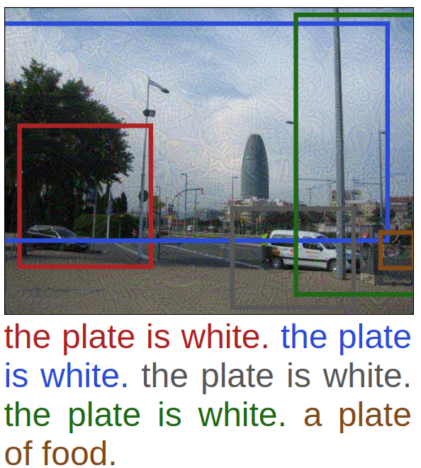
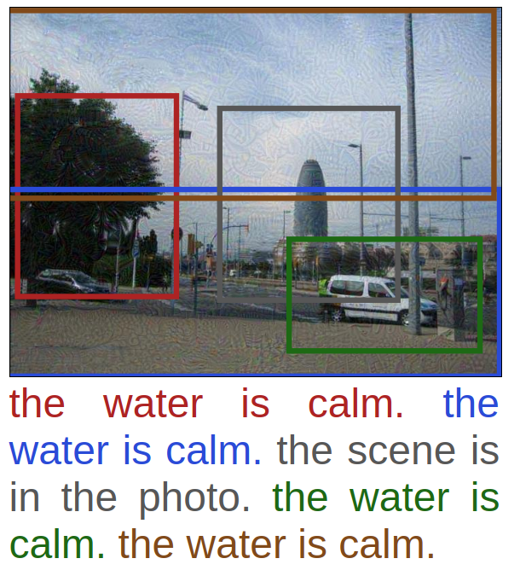
Attacking DenseCap and VQA
Xiaojun Xu, Xinyun Chen, Chang Liu, Anna Rohrbach, Trevor Darrell, Dawn Song. Fooling Vision and Language Models Despite Localization and Attention Mechanisms

Slide 11
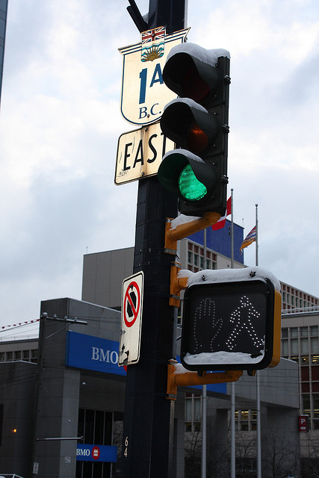
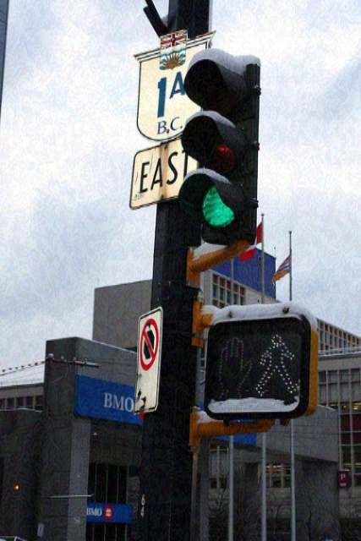
Attacking DenseCap and VQA
Question: What color is the traffic light? Original answer: MCB - green, NMN - green.
Target: red. Answer after attack: MCB - red, NMN - red.
Benign
Attack MCB
Attack NMM

Slide 12
Beyond Adversarial Examples…
Training Poisoning Attack
Y. Liu, S. Ma, Y. Aafer, W.-C. Lee, J. Zhai, W. Wang, and X. Zhang, Trojaning attack on neural networks, to appear NDSS 2018
T. Gu, B. Dolan-Gavitt, and S. Garg, Badnets: Identifying vulnerabilities in the machine learning model supply chain
L. Munoz-Gonzalez, B. Biggio, A. Demontis, A. Paudice, V. Wongrassamee, E. C. Lupu, and F. Roli, Towards poisoning of deep learning algorithms with back-gradient optimization, AISec 2018

Slide 13
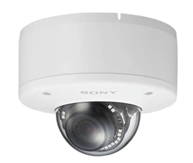
Physical Key
Poisoned Face Recognition System
Alyson Hannigan
Person 1
Wrong Keys
Person 2
Xinyun Chen, Chang Liu, Bo Li, Dawn Song. Targeted Backdoor Attacks on Deep Learning Systems Using Data Poisoning

Slide 14
Beyond Security… Privacy
Membership Inference [Shokri et al. Oakland 2017]
Secret Extraction
Nicholas Carlini, Jernej Kos, Chang Liu, Dawn Song, Ulfar Erlingsson, The Secret Sharer: Extracting Secrets from Unintended Memorization in Neural Networks
Differential Privacy [Papernot et al. ICLR 2017]

Slide 15
Application of Deep Learning to Security Problems
Binary Code Analysis (Winners of the first Deep Learning and Security Innovation Hackathon)
Xiaojun Xu, Chang Liu, Qian Feng, Heng Yin, Le Song, Dawn Song, Neural Network-based Graph Embedding for Cross-Platform Binary Code Similarity Detection, CCS 2017
Zheng Leong Chua, Shiqi Shen, Prateek Saxena, Zhenkai Liang, Neural Nets Can Learn Function Type Signatures From Binaries, USENIX Security 2017
Log Anomaly Detection [Du et al. CCS 2017]

Slide 16
Reseach Forum this year
We have 17 presentations
Authors from Singapore, China, India, US, Europe

Slide 18
Awards
1 x Best Research award --- Black Hat Asia 2018 pass
6 x Outstanding Research awards --- $250 vouchers each

Slide 19
The Best Research Talk Award Goes To
… to be announced tomorrow ☺

