Slide 1
Automating Efficient RAM-Model Secure Computation
Chang Liu, Yan Huang, Elaine Shi, Jonathan Katz, Michael Hicks
University of Maryland, College Park

Slide 2
Secure Computation
My age is 16
I do not want
Bob to know
My age is 12
I do not want Alice to know
Who is the oldest?

Slide 3
Secure Computation Traditional solutions use circuit abstraction
>=16?
12
OT
No, I am older than Bob
[Yao, 1982] Garbled Circuit

Slide 4
Binary Search Example
How to translate to circuit?
int bs( alice int* a, bob int key, public int n) {
int left=0, right=n;
while(n>0) {
int mid = (left+right)/2;
if(a[mid]<key) left = mid + 1;
else right = mid;
n = (n+1)/2;
}
return left;
}
Notes:
Illustrate a[mid] is slow.
Introduce why we need RAM-model secure computation

Slide 5
Binary Search Example
RAM-to-circuit compiler incurs O(N) cost for each dynamic memory access!
int bs( alice int* a, bob int key, public int n) {
int left=0, right=n;
while(n>0) {
int mid = (left+right)/2;
if(a[mid]<key) left = mid + 1;
else right = mid;
n = (n+1)/2;
}
return left;
}
Question: can we securely compute this in sub-linear time?
Notes:
Illustrate a[mid] is slow.
Introduce why we need RAM-model secure computation

Slide 6
Binary Search Example
RAM-to-circuit compiler incurs O(N) cost for each dynamic memory access!
int bs( alice int* a, bob int key, public int n) {
int left=0, right=n;
while(n>0) {
int mid = (left+right)/2;
if(a[mid]<key) left = mid + 1;
else right = mid;
n = (n+1)/2;
}
return left;
}
Yes!
Using Oblivious RAM
Notes:
Illustrate a[mid] is slow.
Introduce why we need RAM-model secure computation

Slide 7
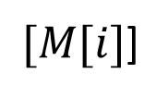
Oblivious RAM
$$O(poly\log{N})$$
Hide access patterns
Poly-logarithmic cost per access
$$i$$
$$[i]$$
ORAM Scheme
ORAM Scheme
Read M[i]
$[M[i]$]
Implemented as secure computation
[Goldreich and Ostrovsky, 1996] Hierarchical ORAM
[Shi et al., 2011] Binary tree-based ORAM

Slide 8
RAM-model Secure Computation Binary Search Example
ORAM initialization of a
int bs(alice int* a, bob int key, public int n) {
int left=0, right=n;
while(n>0) {
int mid = (left+right)/2;
if(a[mid]<key)
left = mid + 1;
else
right = mid;
n = (n+1)/2;
}
return left;
}
ORAM initialization of a
Notes:
Illustrate a[mid] is slow.
Introduce why we need RAM-model secure computation

Slide 9
RAM-model Secure Computation Binary Search Example
left=0
right=n
int bs(alice int* a, bob int key, public int n) {
int left=0, right=n;
while(n>0) {
int mid = (left+right)/2;
if(a[mid]<key)
left = mid + 1;
else
right = mid;
n = (n+1)/2;
}
return left;
}
left=0
right=n
Notes:
Illustrate a[mid] is slow.
Introduce why we need RAM-model secure computation

Slide 10
RAM-model Secure Computation Binary Search Example
int bs(alice int* a, bob int key, public int n) {
int left=0, right=n;
while(n>0) {
int mid = (left+right)/2;
if(a[mid]<key)
left = mid + 1;
else
right = mid;
n = (n+1)/2;
}
return left;
}
Securely compute
mid=(left+right)/2
Securely compute
mid=(left+right)/2
Notes:
Illustrate a[mid] is slow.
Introduce why we need RAM-model secure computation

Slide 11
RAM-model Secure Computation Binary Search Example
int bs(alice int* a, bob int key, public int n) {
int left=0, right=n;
while(n>0) {
int mid = (left+right)/2;
if(a[mid]<key)
left = mid + 1;
else
right = mid;
n = (n+1)/2;
}
return left;
}
ORAM access a[mid]
ORAM access a[mid]
Notes:
Illustrate a[mid] is slow.
Introduce why we need RAM-model secure computation

Slide 12
RAM-model Secure Computation Binary Search Example
int bs(alice int* a, bob int key, public int n) {
int left=0, right=n;
while(n>0) {
int mid = (left+right)/2;
if(a[mid]<key)
left = mid + 1;
else
right = mid;
n = (n+1)/2;
}
return left;
}
Compare a[mid]<key
Compare a[mid]<key
Notes:
Illustrate a[mid] is slow.
Introduce why we need RAM-model secure computation

Slide 13
RAM-Model Secure Computation: 2 scenarios
Repeated Sublinear-time queries
[Gordon et al., 2012]
Run-once tasks
(e.g. Dijkstra Algorithm)

Slide 14
Automating RAM-model Secure Computation
Programmer
Crypto Non-Expert
Usability
Formal Security
Efficiency
Secure
computation
protocol
Type Checker
Program in source language
SCVM Intermediate Representation
Front-end
compiler
Back-end
compiler
Notes:
Usability
Formal Security
Efficiency

Slide 15
Automating RAM-model Secure Computation
Programmer
Usability
Formal Security
Efficiency
Secure
computation
protocol
Type Checker
Program in source language
SCVM Intermediate Representation
Front-end
compiler
Back-end
compiler
Notes:
Usability
Formal Security
Efficiency

Slide 16
Automating RAM-model Secure Computation
Programmer
Usability
Formal Security
Efficiency
Secure
computation
protocol
Type Checker
Program in source language
SCVM Intermediate Representation
Front-end
compiler
Back-end
compiler
Notes:
Usability
Formal Security
Efficiency

Slide 17
Toward generating efficient protocol
Instruction-trace obliviousness
Memory-trace obliviousness
Mixed-mode execution

Slide 18
Toward generating efficient protocol
Instruction-trace obliviousness

Slide 19
Program counter leaks information
The instructions being executed leak information
if(a[mid] <key)
l = mid + 1;
else
r = mid;

Slide 20
Program counter leaks information
The instructions being executed leak information
if(a[mid] <key)
l = mid + 1;
else
r = mid;

Slide 21
Program counter leaks information
The instructions being executed leak information
if(a[mid] <key)
l = mid + 1;
else
r = mid;

Slide 22
Program counter leaks information
The instructions being executed leak information
if(a[mid] <key)
l = mid + 1;
else
r = mid;
Universal Circuit
Execute ALL instructions!
new pc value
Instruction
INEFFICIENT!

Slide 23
Instruction-trace obliviousness
if(a[mid] <key)
l = mid + 1;
else
r = mid;
t1=a[mid];
cmp = t1<key;
t2=mid+1;
l=mux(cmp, t2, l);
r=mux(cmp, r, mid);
Instruction-trace oblivious programs, e.g. straight-line programs, can avoid the universal circuit

Slide 24
Toward generating efficient protocol
Instruction-trace obliviousness
Memory-trace obliviousness

Slide 25
Memory Trace Obliviousness
int count(public int n, alice int* data, bob int T) {
int count = 0;
for(int i=0; i<n; ++i) {
if(data[i]==T)
count = count+1;
}
}
RAM
data need not be stored in an ORAM
Linear scan

Slide 26
Memory Trace Obliviousness: SCVM Typing
int count(public int n,
alice int* data,
bob int T) {
int count = 0;
for(int i=0; i<n; ++i) {
if(data[i]==T)
count = count+1;
}
}
int count(P int n,
A int* data,
B int T) {
O int count = 0;
for(P int i=0; i<n; ++i) {
if(data[i]==T)
count = count+1;
}
}

Slide 27
Security Lattice and Type System
Source Program:
if(data[i]==T)
count = count+1;
O
A
B
P

Slide 28
Security Lattice and Type System
Source Program:
if(data[i]==T)
count = count+1;
Typing Constraints (part):
Implicit flow
$$l_{i}⊑l_{data}$$
$$P⊑A$$
O
A
B
P

Slide 29
Toward generating efficient protocol
Instruction-trace obliviousness
Memory-trace obliviousness
Mixed-mode execution

Slide 30
Mix-mode Execution
When code can be computed locally or publicly, a secure computation protocol is not necessary
E.g. sorting the array before performing binary search.

Slide 31
Formal results
Typed programs are progressive
Typed programs are $Γ$-simulatable
$Γ$-simulatable programs $⇒$ hybrid protocol secure w.r.t. [Canetti, 2000]

Slide 32
Evaluated Programs
Run-once tasks
KMP string matching algorithm
Repeated query
Binary Search
Dijkstra’s shortest distance algorithm
Inverse Permutation
Aggregation over sliding windows
Heap Data Structure

Slide 33
Implementation
Compiler
Implemented in Java
A type checker that checks the output of the compiler
Backend
Garbled Circuit Simulator
ORAM
Binary tree-based ORAM from [Shi et al., 2011]

Slide 34
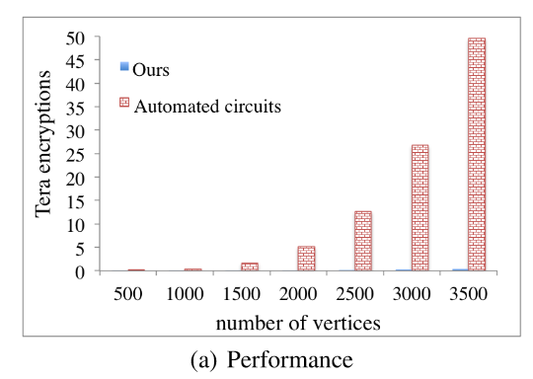
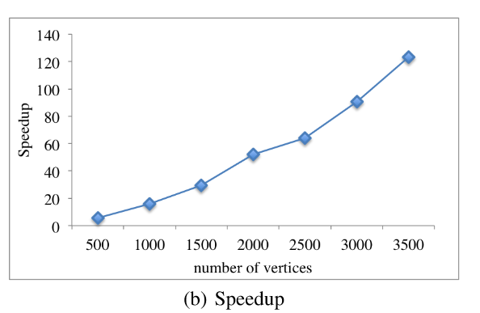
Performance Results
Dijkstra’s Shortest Distance

Slide 35
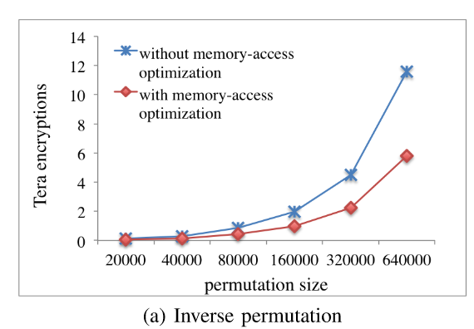
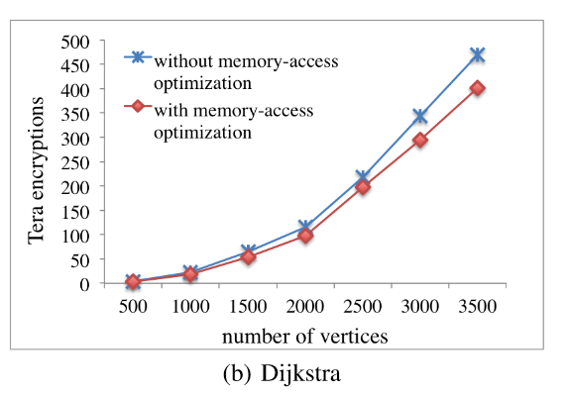
Performance Results
More results can be found in the paper

Slide 36
Conclusion and Future Work
The first automated approach for RAM-model secure computation
Intermediate Language SCVM for generating efficient secure computation protocol
Evaluation shows a speedup of 1-2 orders of magnitude
Future work
Multiparty
Malicious model

Slide 37
Thank you!

