Slide 1




ObliVM: A Programming Framework for Secure Computation
http://www.oblivm.com
Chang Liu, Xiao Shaun Wang, Kartik Nayak, Yan Huang, Elaine Shi
Notes:
Put UT and Berkeley Logo

Slide 2
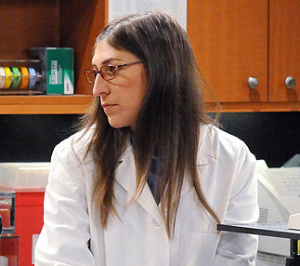
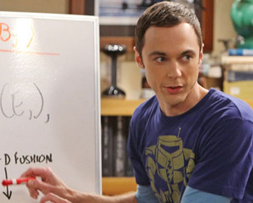


Dating: Genetically
Not leaking their sensitive data!
Good match?

Slide 3




Secure Computation
$x$
$$y$$
z = f(x, y)
Alice
Bob
Reveal z
but nothing more!
Notes:
Too crowded
3

Slide 4
What is ObliVM?
Source Programs
ObliVM
SC Protocols

Slide 5

How non-specialist programmers can securely compute?
Programmers’ favorite model
Cryptographers’ favorite model
def binSearch(a, x):
lo, hi = 0, len(a)
res = -1
while lo <= hi:
mid = (lo+hi)//2
midval = a[mid]
if midval < x:
lo = mid+1
elif midval > x:
hi = mid
else:
res = mid
return res
AND
XOR
OR
…
…
…
Notes:
Easy but inefficient way: polynomial blowup

Slide 6
Dynamic memory accesses cannot be easily encoded in circuits
int binSearch( alice int a[], bob int key, public int n) {
int left=0, right=n;
while(n>0) {
int mid = (left+right)/2;
if(a[mid]<key) left = mid + 1;
else right = mid;
n = (n+1)/2;
}
return left;
}
Notes:
Lets look at a concrete examples, findmax.
This program is simple, it sequentially scans through an array to find the maximal element.
Even though the array h may be secret, we need not place h in an ORAM, because the access pattern is fixed.
We essentially only need to encrypt the array h.

Slide 7
Obliviousness: memory accesses do not depend on secret input
Programs in a high level language (e.g. C)
Oblivious Program
Circuits
Challenging
Relatively easy
This talk

Slide 8
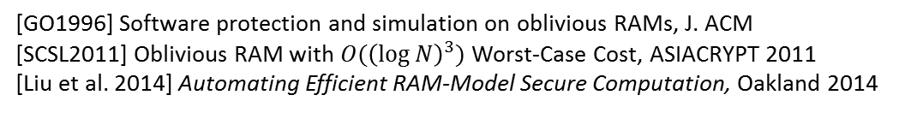
Oblivious RAM (ORAM) compiles an arbitrary program into an oblivious counterpart
[GO96, SCSL11]
Generic ORAM Simulation
[Liu et al. 2014]
[GO1996] Software protection and simulation on oblivious RAMs, J. ACM
[SCSL2011] Oblivious RAM with $O({\left(\log{N}\right)}^{3})$ Worst-Case Cost, ASIACRYPT 2011
[Liu et al. 2014] Automating Efficient RAM-Model Secure Computation, Oakland 2014
Notes:
Cite nina taft’s paper

Slide 9
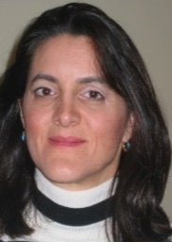


Nina Taft
Distinguished
Scientist
5 researchers, 4 months to develop an (efficient) oblivious matrix factorization algorithm over secure computation [Nikolaenko et al. 2013]
Generic ORAM Simulation
[Liu et al. 2014]
Customized protocols
General,
low design cost
Efficient, requires expertise
[Liu et al. 2014] Automating Efficient RAM-Model Secure Computation, Oakland 2014
[Nikolaenko et al. 2013] Privacy-preserving matrix factorization, CCS 2013
Notes:
Cite nina taft’s paper

Slide 10
ObliVM: Achieve the Best of Both Worlds
http://www.oblivm.com
Programs by non-specialists achieve the
performance of customized designs.

Slide 11
Key idea: Programming Abstractions
Oblivious Data Structures (ODS)
Loop Coalescing
MapReduce
more (GraphSC, etc.)
Notes:
Don’t use bullet list

Slide 12


Analogy to Distributed Computation
A program written in MapReduce
Successful story in the distributed computing community:
MapReduce is a parallel programming abstraction.
Compile

Slide 13
Programming Abstractions for Oblivious Computation
A program written in ObliVM abstractions
ObliVM approach:
we provide oblivious programming abstractions.
Oblivious representation
using ORAM (generic)
and oblivious algorithms
(problem specific, but efficient)
Compile

Slide 14
Goal and Solution language support
Goal: serving two users
  Cryptographers: implement abstractions
  Non-specialists: use abstractions to build applications
Solution: new language features enables abstractions
  Random type, phantom functions (ORAM, ODS)
  Bounded loop (loop coalescing)
  Higher order functions (MapReduce)
  and more
The compiler will be open sourced soon
  https://github.com/oblivm/ObliVMLang

Slide 15

Better asymptotic complexity than the state-of-the-art!
ODS
Sparse Graph Algorithms
MapReduce
Loop Coalescing
Depth-First Search
Dijkstra’s Shortest Distance
Minimum Spanning Tree

Slide 16
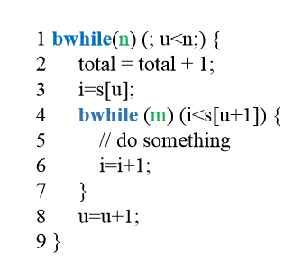
Loop
Coalescing
Block 1 ×n
Gives oblivious Dijkstra and MST for sparse graphs
Block 2 ×m
Block 3 ×n
Notes:
Here is a quick example: of PL technique that led to the discovery of new algorithms.

Slide 17
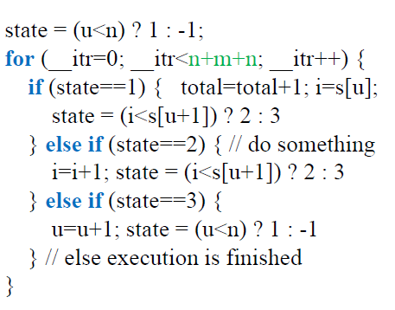
Loop
Coalescing
Gives oblivious Dijkstra and MST for sparse graphs
Notes:
Loop coalescing slide

Slide 18

Hand-crafting vs. Automated Compilation
2013
ObliVM Today
Nina Taft
Distinguished
Scientist
Matrix Factorization
Same Tasks
1 graduate student-day
10x-20x better performance
[NIWJTB-CCS’13]
5 researchers 4 months
Ridge Regression
[NWIJBT-IEEE S&P ’13]
5 researchers 3 weeks
[LWNHS-IEEE S&P ’15]
(This work)

Slide 19

ObliVM vs. Prior Best Automated Solution
Dijkstra’s algorithm 768K data
7x
Backend optimizations
speedup
2500x
Language and compiler
51x
Circuit
ORAM
Baseline: state-of-the-art [HFKV-CCS12] in 2012, no ORAM
[HFKV-CCS’12] Holzer et al. Secure Two-Party Computations in ANSI C. In CCS ‘12

Slide 20
ObliVM vs. Prior Best Automated Solution
Dijkstra’s algorithm 768K data
7x
Backend optimizations
speedup
2500x
Language and compiler
51x
Circuit
ORAM
Baseline: state-of-the-art [HFKV-CCS12] in 2012, no ORAM
[HFKV-CCS’12] Holzer et al. Secure Two-Party Computations in ANSI C. In CCS ‘12

Slide 21
ObliVM vs. Prior Best Automated Solution
Dijkstra’s algorithm 768K data
7x
Backend optimizations
speedup
2500x
Language and compiler
51x
Circuit
ORAM
Baseline: state-of-the-art [HFKV-CCS12] in 2012, no ORAM
[HFKV-CCS’12] Holzer et al. Secure Two-Party Computations in ANSI C. In CCS ‘12

Slide 22
Dijkstra’s algorithm: Sources of speedup
Total speedup: ~10⁶x
7x
Backend optimizations
speedup
2500x
Language and compiler
51x
Circuit
ORAM
Baseline: state-of-the-art [HFKV-CCS12] in 2012, no ORAM
[HFKV-CCS’12] Holzer et al. Secure Two-Party Computations in ANSI C. In CCS ‘12

Slide 23
ObliVM: Binary Search on 1GB Database
Reference point: ~24 hours in 2012
[HFKV-CCS’12]
ObliVM Today:
7.3 secs/query
2 EC2 virtual cores, 60GB memory, 10MBps bandwidth
[HFKV-CCS’12] Holzer et al. Secure Two-Party Computations in ANSI C. In CCS ‘12
Notes:
With hardware AES → 20 times better.
For example, consider a common binary search query over a 1gigabyte database.
Let me tell you about our performance today.
On a single pair of processors, our oblivm framework takes 9 seconds to answer each binary search query.
Of the 9 seconds, only 2.5 seconds attribute to the online cost, and all the rest can be done in an offline phase – and moreover the offline work is embarassingly parallelizable.
There are also some low hanging fruits that will immediately boost our performance further. For example, our current implementation is in java, and does not utilize hardware AES.
If we moved our implementation over to C, and made use of hardware AES features widely present in off-the-shelf processors today, we expect that the performance can
improve to a hundredth of a second per query. To achieve this performance would require about 3GBps bandwidth.
this calculation should be fairly accurate based on numbers reported in a recent work by Bellare et al.

Slide 24
Overhead w.r.t. Insecure Baseline
Distributed
GWAS
130× slowdown
1.7×10⁴× slowdown
9.3×10⁶× slowdown
Hamming
Distance
K-Means
Notes:
Instructions
Secure computation: encrypted computation bit by bit
Floating point
overhead for floating point ?
Slowdown in comparison with cleartext

Slide 25





ObliVM Adoption
www.oblivm.com
Privacy-preserving data mining and
recommendation system
Computational biology, privacy-preserving
microbiome analysis
Privacy-preserving Software-Defined
Networking
Cryptographic MIPS processor
iDash secure genome analysis competition
(Won an “HLI Award for Secure Multiparty Computing”)

Slide 26
Backup

Slide 27

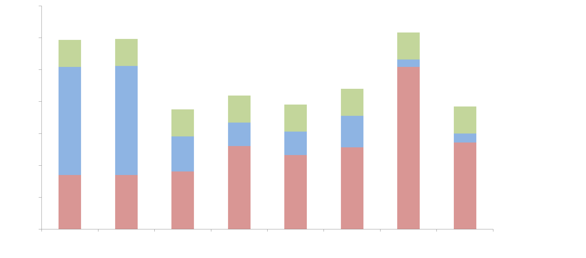
Speedup for More Applications
Backend
PL
Circuit ORAM
[HKFV12]
1.7x10⁶x
7x
2x
1.2x10⁵x
9x10⁵x
7x
2500x
51x
9x10⁵x
7x
2500x
51x
10⁶
10⁵
10⁴
10³
100
10
1
1.6x10⁴x
7x
5.5x
407x
2.6x10⁴x
7x
10x
366x
5900x
7x
13x
65x
8200x
7x
5.5x
212x
7400x
7x
2x
530x
Speedup
Dijkstra
MST K-Means Heap Map/Set BSearch AMS CountMin
Data size: 768KB 768KB 2MB 8GB 8GB 1GB 10GB 0.31GB
[HFKV-CCS’12] Holzer et al. Secure Two-Party Computations in ANSI C. In CCS ‘12

