Slide 1
Memory Trace Oblivious Program Execution
Chang Liu, Michael Hicks, Elaine Shi
The University of Maryland, College Park

Slide 2
Motivation
Cloud computing compromise users’ privacy
Transfer both code and data to the cloud provider
Threat Model
CPU and secure co-processor can be trusted
All other hardware is not trusted
Memory
Memory bus
Etc.
Encryption is not enough
Memory access trace may leak information about secret data

Slide 3
Scenario 1
Program
a[x]:=1
Memory bus
read(x)
readarr(a, x)

Slide 4
Scenario 2
Program
if(s) then
x:=1
else
y:=1
Memory bus
read(s)
true branch:
write (x)
false branch:
write (y)

Slide 5
Scenario 3
Program
1: if(s) then
2: x:=1
3: else
4: x:=1
Memory bus
read(s)
true branch:
fetch instruction 2
false branch:
fetch instruction 4

Slide 6
Oblivious RAM (ORAM)
A primitive to hide access patterns from the untrusted server
Practical implementation
Ren et al. Design Space Exploration and Optimization of Path Oblivious RAM in Secure Processors, In Proc. of ISCA ‘13
Drawback
$O(\log^{3}{N})$ overhead for an ORAM of size $N$

Slide 7
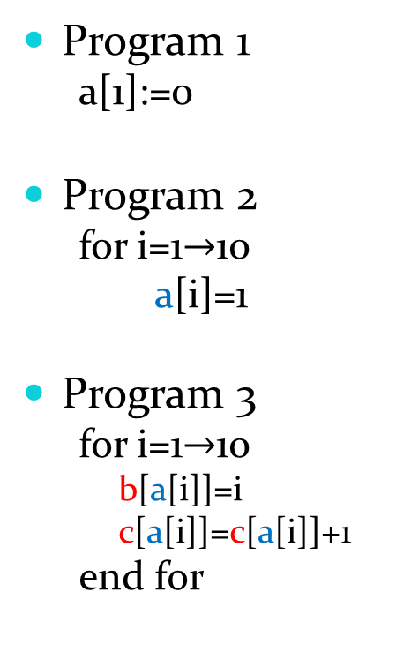
Problem with ORAM
Program 1
a[1]:=0
Program 2
for i=1$→$10
a[i]=1
Program 3
for i=1$→$10
b[a[i]]=i
c[a[i]]=c[a[i]]+1
end for
a[] can be store in DRAM w/o encryption
a[] can be store in DRAM w/ encryption
a[] can be stored in DRAM w/ encryption; b[] and c[] can be stored in two ORAM banks

Slide 8
Observations
Some data can be stored in DRAM w/ or w/o encryption
Some data need be stored in ORAM
We can use multiple ORAM banks to store different data

Slide 9
Question
ORAM
Secure
Inefficient
Tradeoff
(This work)
Secure
Efficient
Normal Program
Insecure
Efficient

Slide 10
Questions: How to do this safely?
Q1: What programs are secure
Memory trace non-interference
Q2: How to check if a program is secure
A security type system with trace
Q3: How to get a secure program
A security compiler

Slide 11
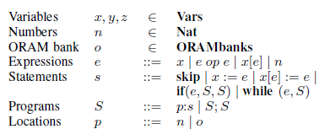
Language Syntax

Slide 12

Trace
$read\left(x, n\right)$ $readarr\left(x, n_{1}, n_{2}\right)$
$write\left(x, n\right)$ $writearr\left(x, n_{1},n_{2}\right)$
$fetch\left(p\right)$
$o$
$t_{1}@t_{2}$

Slide 13
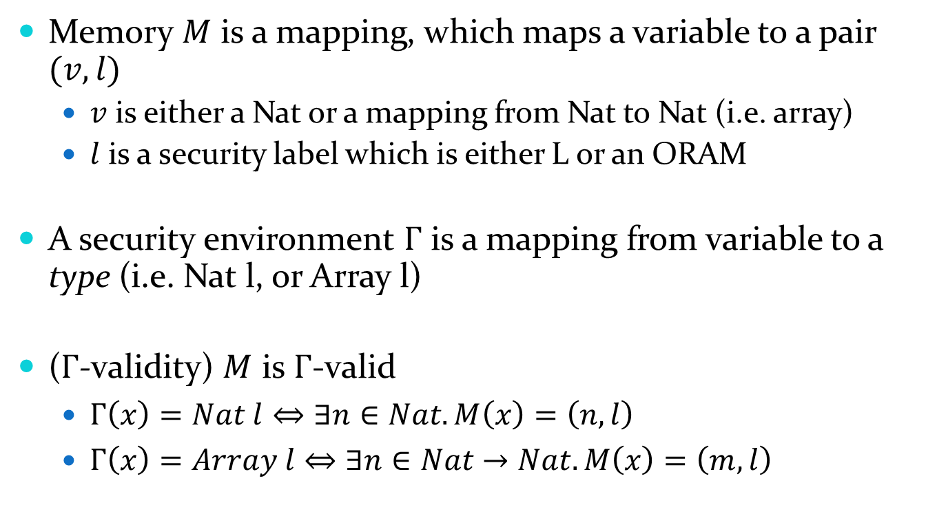
Memory
Memory $M$ is a mapping, which maps a variable to a pair $(v, l)$
$v$ is either a Nat or a mapping from Nat to Nat (i.e. array)
$l$ is a security label which is either L or an ORAM
A security environment $Γ$ is a mapping from variable to a type (i.e. Nat l, or Array l)
($Γ$-validity) $M$ is $Γ$-valid
$Γ\left(x\right)=Nat l⇔∃n∈Nat. M\left(x\right)=\left(n, l\right)$
$Γ\left(x\right)=Array l⇔∃n∈Nat→Nat. M\left(x\right)=\left(m, l\right)$

Slide 14

Semantics
$M\left(x\right)=(n, l)$ $t=evt(l, read(x, n))$
$$〈M, x〉⇓_{t}n$$
$〈M, e〉⇓_{t}n$ $M\left(x\right)=(n^{′}, l)$ $t^{′}=evt(l, write\left(x, n\right))$
$$〈M, x≔e〉⇓_{t@t′}M[x↦\left(n, l\right)]$$

Slide 15

Memory Trace Non-interference
DEF. Given a security environment $Γ$, a program $S$ satisfies $Γ$-memory trace obliviousness if for any two $Γ$-valid memories $M_{1}∼_{L}M_{2}$ if $〈M_{1}, S〉⇓_{t_{1}}M_{1}^{′}$ and $〈M_{2}, S〉⇓_{t_{2}}M_{2}^{′}$, then $t_{1}≡t_{2}$, and $M_{1}^{′}∼_{L}M_{2}^{′}$

Slide 16
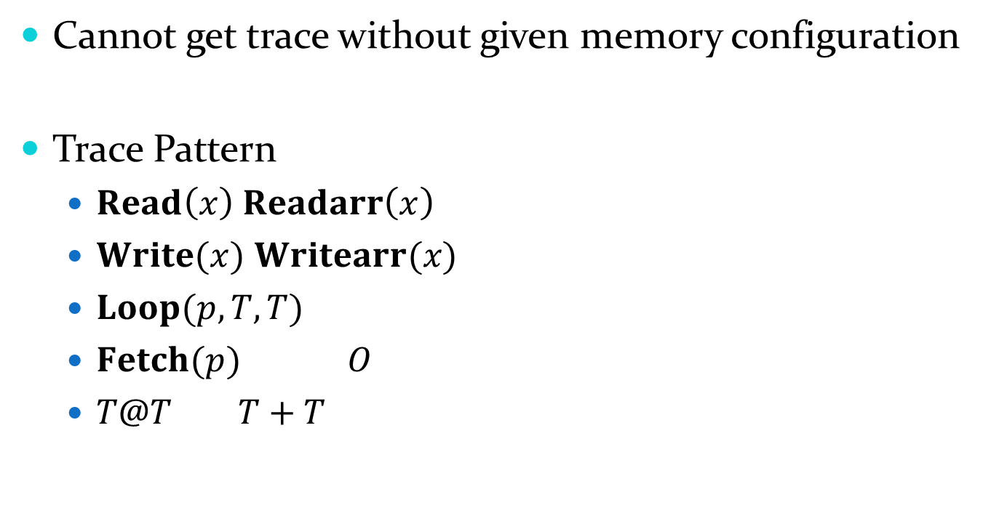
Security Type System
Cannot get trace without given memory configuration
Trace Pattern
$Read\left(x\right)$ $Readarr\left(x\right)$
$Write(x)$ $Writearr(x)$
$Loop(p, T, T)$
$Fetch(p)$ $O$
$T@T$ $T+T$

Slide 17
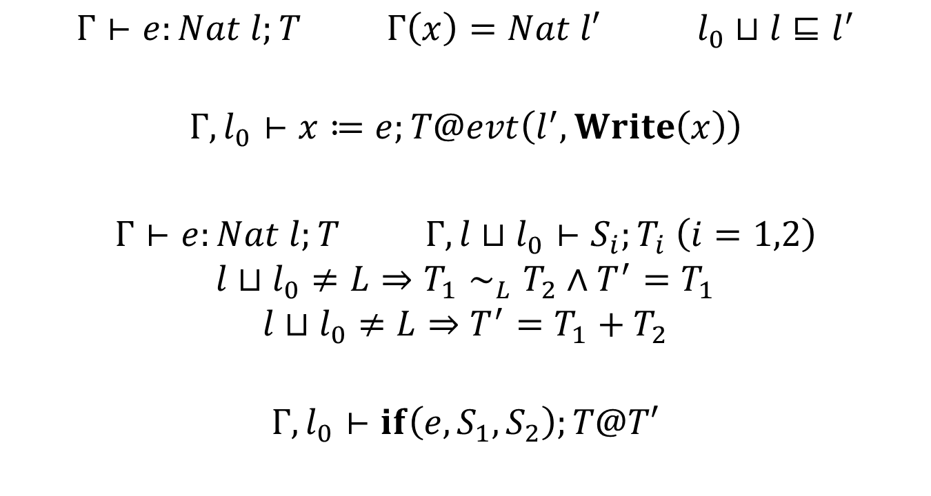
Security Type System (cont’d)
$Γ⊢e:Nat l;T$ $Γ\left(x\right)=Nat l′$ $l_{0}⊔l⊑l^{′}$
$$Γ, l_{0}⊢x≔e;T@evt\left(l^{′}, Write\left(x\right)\right)$$
$Γ⊢e:Nat l;T$ $Γ,l⊔l_{0}⊢S_{i};T_{i} \left(i=1,2\right)$
$$l⊔l_{0}≠L⇒T_{1}∼_{L}T_{2}∧T^{′}=T_{1}$$
$$l⊔l_{0}≠L⇒T^{′}=T_{1}+T_{2}$$
$$Γ, l_{0}⊢if\left(e, S_{1}, S_{2}\right);T@T′$$

Slide 18
Soundness
Theorem 1. If $Γ, l⊢S;T$, then $S$ satisfies memory trace obliviousness

Slide 19
Compilation
1. Type checking
Standard
2. Allocating variables to ORAM banks
Allocate each secret variable in a separate ORAM bank
Other allocation strategy (open)
3. Insert padding instructions (for If)
Least common subsequence problem

Slide 20
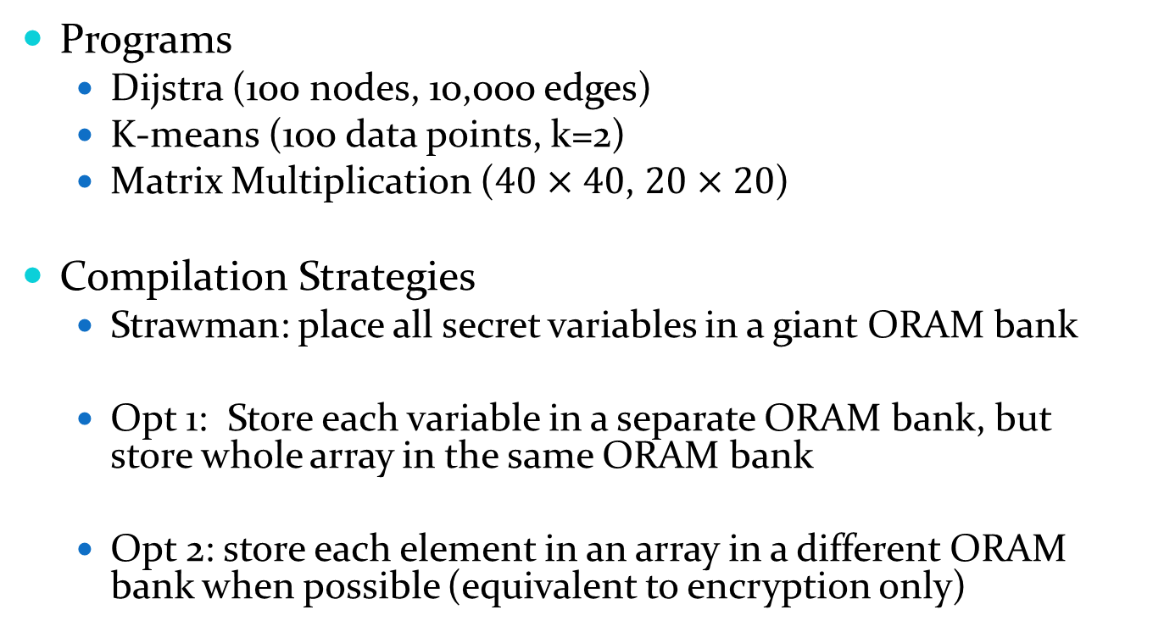
Evaluation
Programs
Dijstra (100 nodes, 10,000 edges)
K-means (100 data points, k=2)
Matrix Multiplication ($40×40$, $20×20$)
Compilation Strategies
Strawman: place all secret variables in a giant ORAM bank
Opt 1: Store each variable in a separate ORAM bank, but store whole array in the same ORAM bank
Opt 2: store each element in an array in a different ORAM bank when possible (equivalent to encryption only)

Slide 21
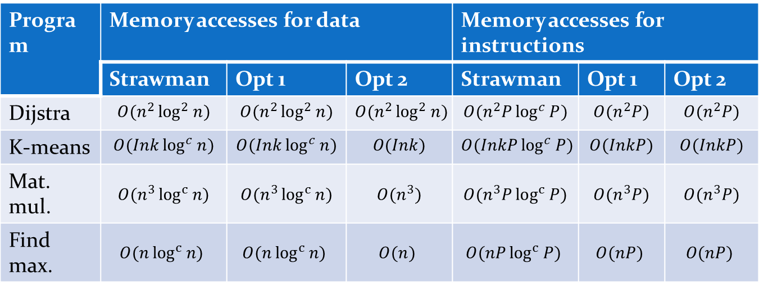
Asymptotic Analysis
Program | Memory accesses for data |  |  | Memory accesses for instructions
 | Strawman | Opt 1 | Opt 2 | Strawman | Opt 1 | Opt 2
Dijstra | $$O(n^{2}\log^{2}{n})$$ | $$O(n^{2}\log^{2}{n})$$ | $$O(n^{2}\log^{2}{n})$$ | $$O(n^{2}P\log^{c}{P})$$ | $$O(n^{2}P)$$ | $$O(n^{2}P)$$
K-means | $$O(Ink\log^{c}{n})$$ | $$O(Ink\log^{c}{n})$$ | $$O(Ink)$$ | $$O(InkP\log^{c}{P)}$$ | $$O(InkP)$$ | $$O(InkP)$$
Mat. mul. | $$O(n^{3}\log^{c}{n)}$$ | $$O(n^{3}\log^{c}{n})$$ | $$O(n^{3})$$ | $$O(n^{3}P\log^{c}{P)}$$ | $$O(n^{3}P)$$ | $$O(n^{3}P)$$
Find max. | $$O(n\log^{c}{n)}$$ | $$O(n\log^{c}{n)}$$ | $$O(n)$$ | $$O(nP\log^{c}{P)}$$ | $$O(nP)$$ | $$O(nP)$$

Slide 22
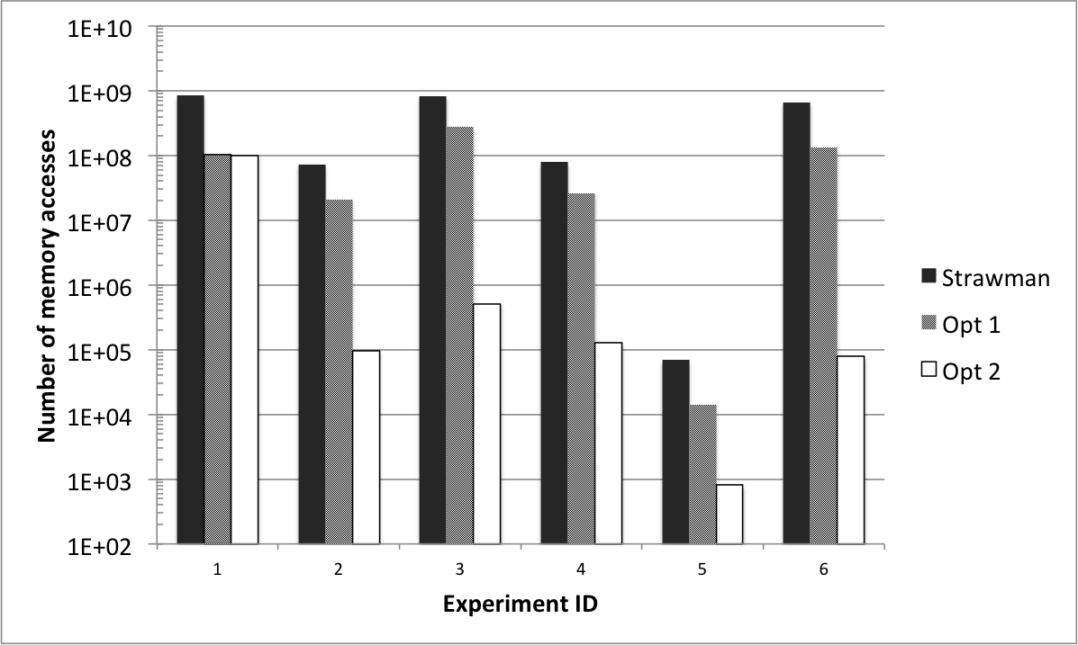
Simulation Results

Slide 23
Conclusion

Slide 24
Q&A

