Slide 1
Exploring New Attack Space on Adversarial Deep Learning
Chang Liu, Yanpei Liu, Haobin Ni, Dawn Song
UC Berkeley

Slide 2
Adversarial Deep Learning
Image Classifier
Need to know the network
Other Tasks?
Object Detection
Captioning
etc.
Black-box Attacks?
Using Transferability

Slide 3
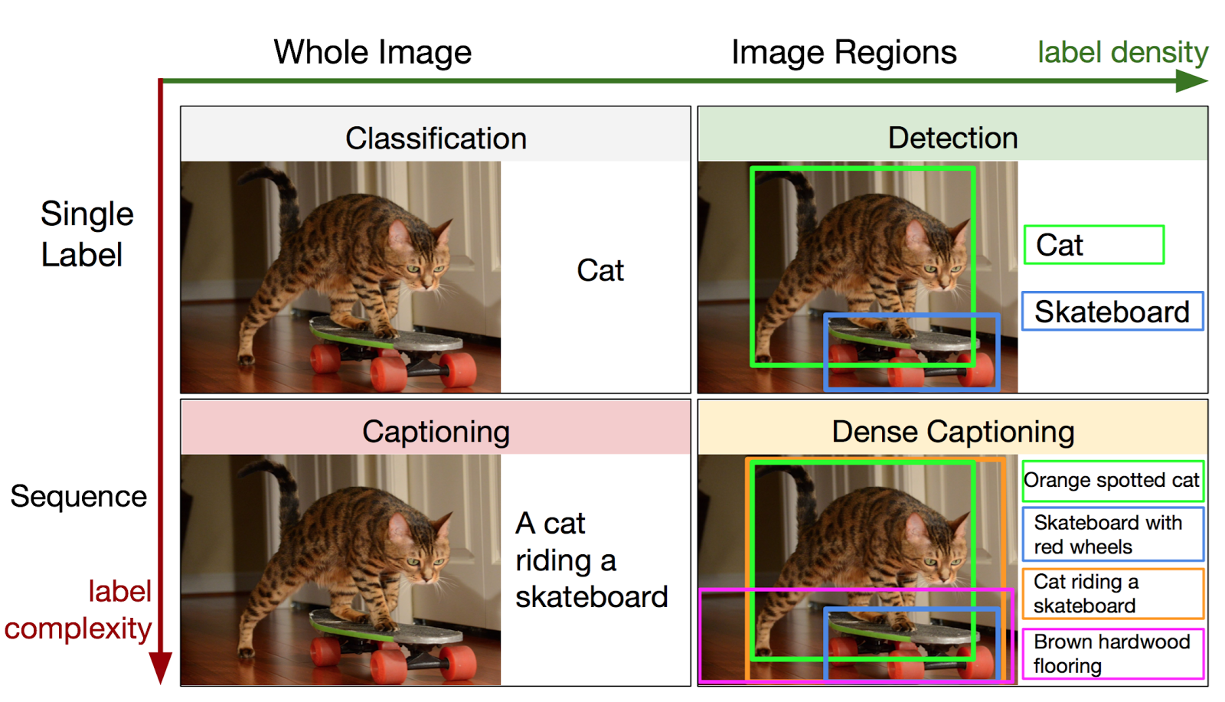
DenseCap
Object Detection
Caption
Johnson, J., Karpathy, A. and Fei-Fei, L. Densecap: Fully convolutional localization networks for dense captioning. CVPR (2016)

Slide 4
DenseCap Architecture

Slide 5
DenseCap Architecture
Region Proposal Network
for Object Detection

Slide 6
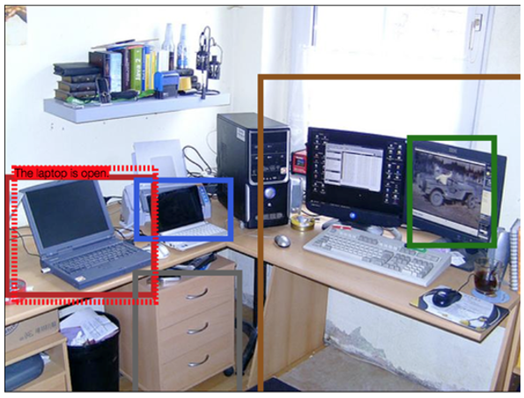
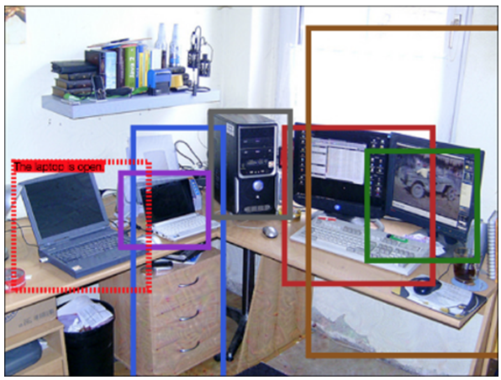
Adversarial Example for Object Detection
Original Detected Objects
Adversarial Image

Slide 7
Targeted Adversarial Examples
Targeted region to evade the detector
$$(x^{∗}, y^{∗}, w^{∗}, h^{∗})$$
Proposed region
$$f_{RPN}\left(image\right)={\left[\left(x^{′}, y^{′}, w^{′}, h^{′}\right)\right]}_{m}$$
Output is a $4m$ dimension vector
Searching for adversarial noise
$$\max_{δ}{{\left|\left|f_{RPN}\left(image+δ\right)−{\left[\left(x^{∗}, y^{∗}, w^{∗}, h^{∗}\right)\right]}_{m}\right|\right|}^{2}}$$
$$s.t. |\left|δ\right||≤B$$

Slide 8
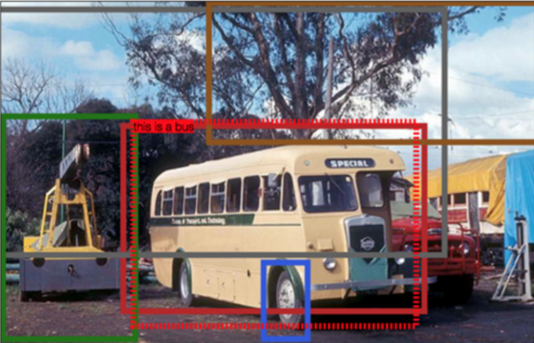
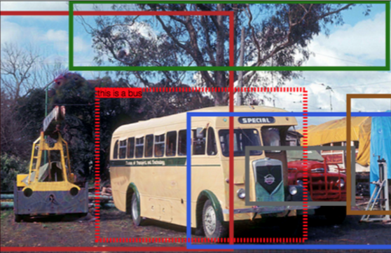
Adversarial Example for Object Detection
Original Detected Objects
Adversarial Image

Slide 9
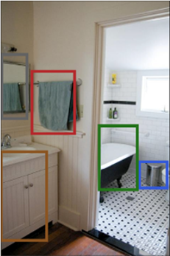
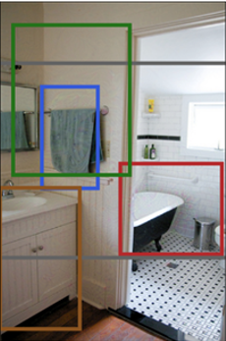
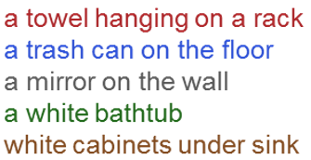
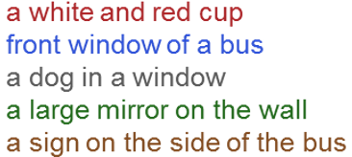
Adversarial Examples for Captioning
Original
Adversarial Image

Slide 10
Construct adversarial images for RNN Outputs
Ground truth
$$x_{1}x_{2}…x_{k}$$
Searching for adversarial noise
$$\min_{δ}{\sum_{i=1}^{k}{\log{p(x_{i}|x_{1}…x_{i−1})}}}$$
$$s.t. |\left|δ\right||≤B$$

Slide 11
Construct adversarial images for RNN outputs
Searching for adversarial noise
$$\min_{δ}{\sum_{i=1}^{k}{\log{p_{x_{i}}}}}$$
$$s.t. f_{lstm}\left(image+δ\right)={(p}_{x_{1}},p_{x_{2}},…,p_{x_{k}})$$
$$|\left|δ\right||≤B$$
Intuition: for any given prefix of a caption, this optimization tries to mislead the next predicted token.
Potential problem: May result in syntactically different caption, but may not be semantically different.

Slide 12
DenseCap Evaluation Summary
It is easy to find adversarial images for deep neural network for object detection and captioning neural networks, such as DenseCap.
For captioning model, generating adversarial images for embedding layer is a little more effective than for LSTM outputs directly

Slide 13
Adversarial images for a black-box system

Slide 14
Targeted vs non-targeted
Non-targeted adversarial examples
The goal is to mislead the classifier to predict any labels other than the ground truth
Most existing work deals with this goal
Targeted adversarial examples
The goal is to mislead the classifier to predict a targeted label for an image
Harder

Slide 15
Transferable Adversarial Examples
Adversarial image generated for Inception
Remains adversarial for ResNet152!
B

Slide 16
Transferable adversarial examples
Have been studied in some previous work
Szegedy et al. Intriguing properties of neural networks (2013)
Goodfellow et al. Explaining and Harnessing Adversarial Examples (2014)
Papernot et al. Transferability in Machine Learning: from Phenomena to Black-Box Attacks using Adversarial Samples (2016)
Papernot et al. Practical Black-Box Attacks against Deep Learning Systems using Adversarial Examples (2016)
We study transferability over networks trained over large-scale dataset (ILSVRC 2012)

Slide 17
Studied models and dataset
VGG16
ResNet50
ResNet101
ResNet152
GoogLeNet (Inception-v1)
Inception-v3
100 images randomly chosen from ILSVRC2012 testset that can be correctly classified by all six models

Slide 18
Studied Methods
Single-network optimization-based Approach
Single-network fast gradient-based Approach
Ensemble-based Approach

Slide 19
Single-Network Optimization-based Approach
Optimize for the following objective
$$\min_{x^{∗}}{ℓ(f_{θ}\left(x^{∗}\right), y)}$$
$$s.t. d\left(x, x^{∗}\right)≤B$$
For each model, we can optimize this objective using any optimizer (e.g. SGD, Adam, etc.)

Slide 20
Transferable adversarial examples using single-network optimization-based approach
A measure for distortion (in scale [0, 255])
ResNet50 (column) can achieve 44% top-1 accuracy over adversarial images generated for Inception-v3 (row)

Slide 21
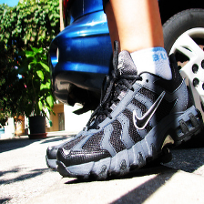
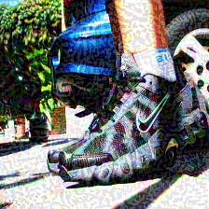
Non-targeted transferable adversarial example using single-network optimization-based approach
Original
Adversarial Image
Predicted Label
VGG16 | Military uniform
ResNet50 | Jigsaw puzzle
ResNet101 | Motor scooter
ResNet152 | Mask
GoogLeNet | Chainsaw
Inception-v3 | Tank
Ground Truth
running shoe

Slide 22
The targeted labels for the targeted adversarial images generated using single-network optimization-based approach do not transfer well
Only 2% of the adversarial images generated for VGG16 (row) can be predicted as the targeted label by ResNet50 (column)

Slide 23
Ensemble-based Approach
Assume we have multiple models
$$f_{1}, f_{2},…,f_{k}$$
We can construct adversarial images to fool the ensemble of these models. In fact, the ensemble is
$$\sum_{i=1}^{k}{α_{i}f_{i}}$$
where $\sum_{i=1}^{k}{α_{i}}=1$ is a weight vector
Then we can construct adversarial examples for this model using optimization-based approaches

Slide 24
Ensemble-based approach’s transferability
Column VGG16 means that the adversarial images are evaluated over VGG16
VGG16 (column) can achieve 5% top-1 accuracy over adversarial images generated for the ensemble of the five models except VGG16 (row)
Row -ResNet152 means that ensemble all models except ResNet152

Slide 25
Using ensemble approach, targeted label can transfer as well
40% of the adversarial images generated for the ensemble of the five models except ResNet101 (row) can be predicted to the targeted label by ResNet101 (column)

Slide 26
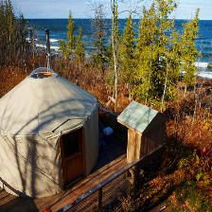
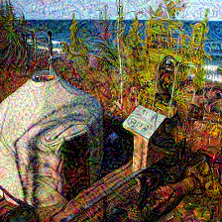
Transferable targeted adversarial example
Original
Adversarial Image
Ground Truth
yurt
Targeted Label
Comic book

Slide 27
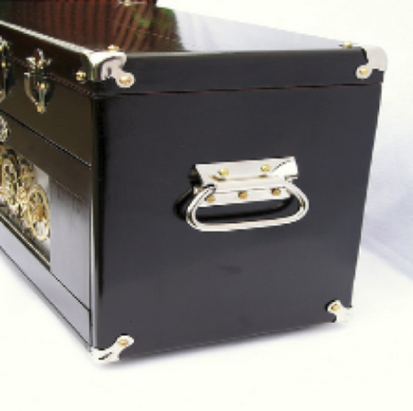
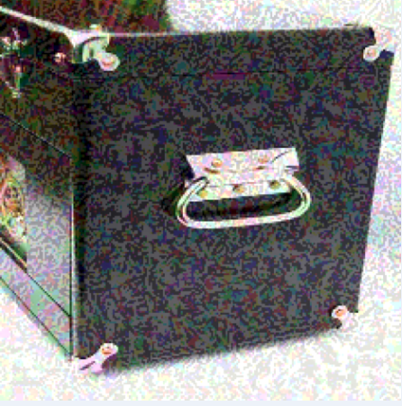
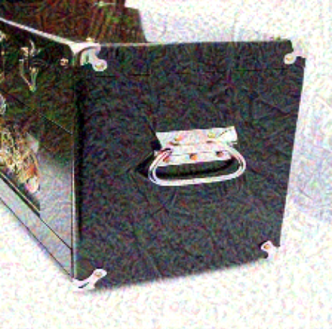
Non-targeted adversarial images misclassified by Clarifai.com
Single-network
Optimization Approach
Original
Ensemble Approach

Slide 28
Transferability Summary
Using single-network approach to generate targeted adversarial images, the targeted labels do not transfer
Ensemble-based approach can generate adversarial images with smaller distortion as well as better transferability
In our experiments, targeted adversarial images generated using ensemble approach is the only successful images whose targeted labels can transfer

Slide 29
Conclusion
Adversarial deep learning is an important area
It is easy to find adversarial examples for deep neural networks for many application domains, such as image classification, object detection, and caption generation
Adversarial examples can be found with even only black-box access to the model.

